Slide 1
THE HYDRO-ELECTRIC POWER
THE WATER-WHEEL
SAVING ELECTRICAL ENERGY

Slide 2

PROBLEM STATEMENT
THE LAGOS STATE UNIVERSITY, PARTICULARLY THE EPE CAMPUS, IS FACING A SEVERE SHORTAGE OF ELECTRICITY. THIS ISSUE AFFECTS BOTH STUDENTS AND STAFF, HINDERING ACADEMIC ACTIVITIES SUCH AS LABORATORY WORK AND PRACTICAL EXERCISES. THE LACK OF POWER ALSO LEADS TO WATER SCARCITY, LIMITED ACCESS TO TECHNOLOGY, AND INCREASED LIVING COSTS FOR STUDENTS. THE INADEQUATE ELECTRICITY SUPPLY LASTS FOR ONLY ABOUT 3 HOURS PER DAY, WITH THE NATIONAL ELECTRIC SUPPLY OFFERING LIGHT FOR AN AVERAGE OF 2 DAYS A WEEK, LASTING ABOUT 1-3 HOURS.

Slide 3
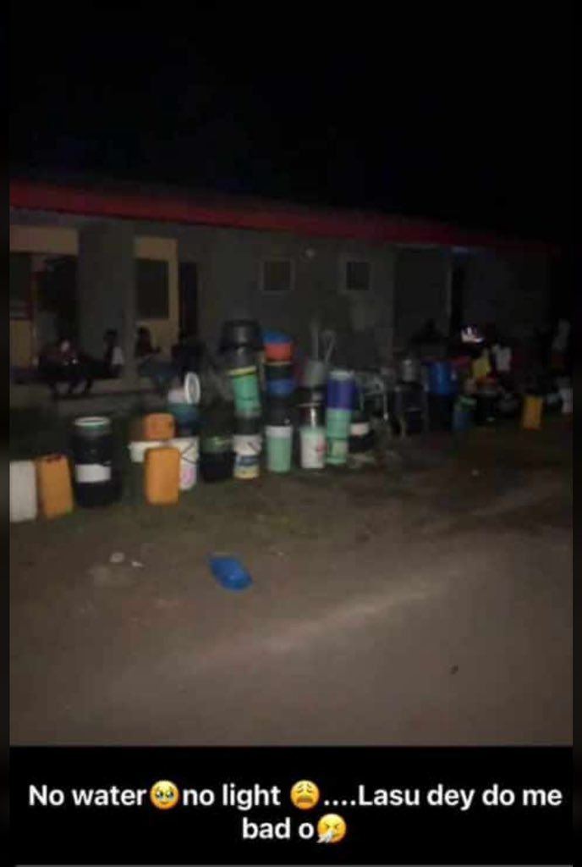
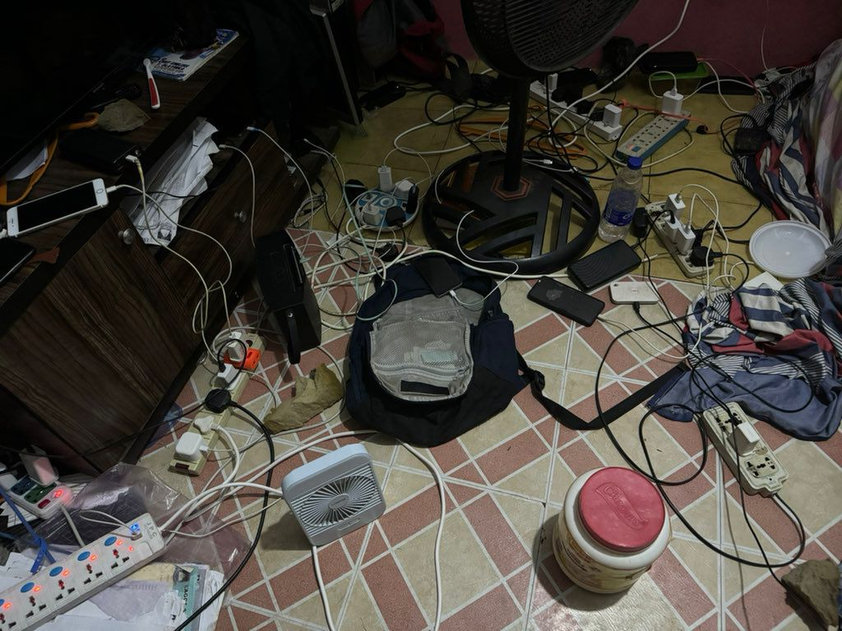

Slide 4
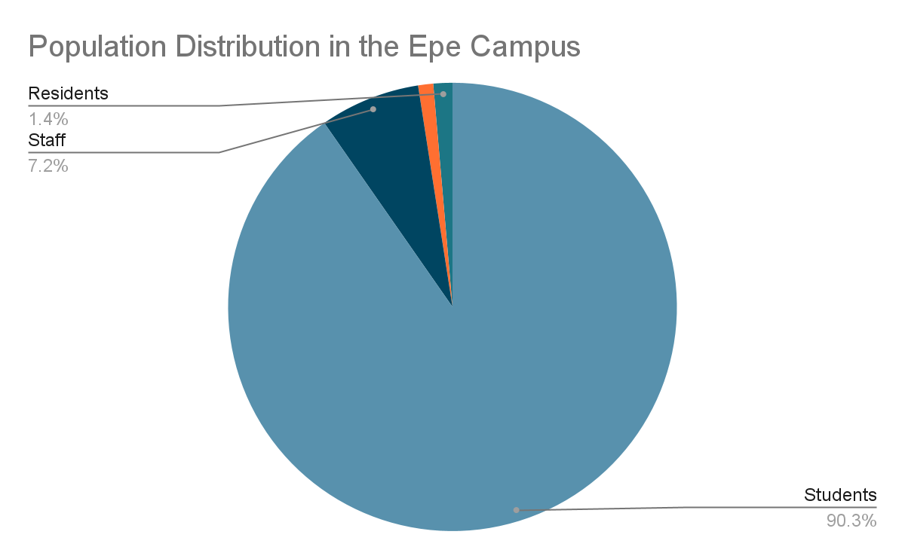

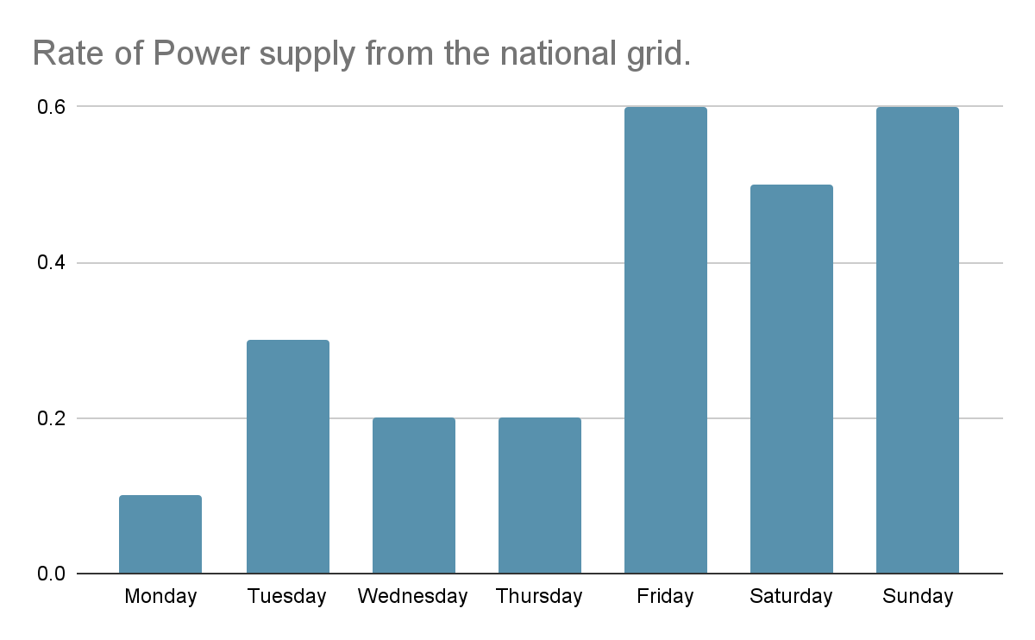
This shows the population density in the Epe campus. All population experience the problem of blackout some nights, and the students are largely affected.
This shows the the rate of power supply from the national grid per week.
It shows that power if supplied most frequently, if supplied at all, on the weekends and therefore is not beneficial enough to the weekly needs and class activities, laboratories or practicals of the students.

Slide 5
SOLUTION OVERVIEW
HARDWARE:
THE UTILIZATION OF WATER FLOW TO GENERATE ELECTRICITY THROUGH A WATER WHEEL IS A TRADITIONAL YET HIGHLY EFFECTIVE METHOD. IT INVOLVES HARNESSING THE KINETIC ENERGY OF A FLOWING WATER TO ROTATE A WHEEL, WHICH IN TURN POWERS AN ELECTRICAL GENERATOR THROUGH MECHANICAL TRANSMISSION UNITS.
A WATER WHEEL, ALSO KNOWN AS A HYDRO POWER WHEEL OR WATER TURBINE, IS A DEVICE DESIGNED TO CONVERT THE ENERGY OF FLOWING WATER INTO MECHANICAL ENERGY. IT TYPICALLY CONSISTS OF A LARGE WHEEL WITH BLADES ATTACHED AROUND IT’S CIRCUMFERENCE. WHEN WATER FLOWS OVER OR UNDER THE WHEEL, IT ROTATES THEREBY CONVERTING THE KINETIC ENERGY OF THE WATER INTO ROTATIONAL ENERGY.
SOFTWARE:
A SOFTWARE SYSTEM THAT HELPS TO SAVE THE OUTPUT POWER FROM THE WATER WHEEL, THEREBY MAXIMIZING EFFICIENCY. THIS IS DONE BY CHANNELING THE POWER TO SPECIFIC AND IMPORTANT LECTURE ROOMS, PRACTICALS OR CLASSES THAT WOULD REQUIRE ELECTRICITY FOR OPTIMUM LEARNING.

Slide 6
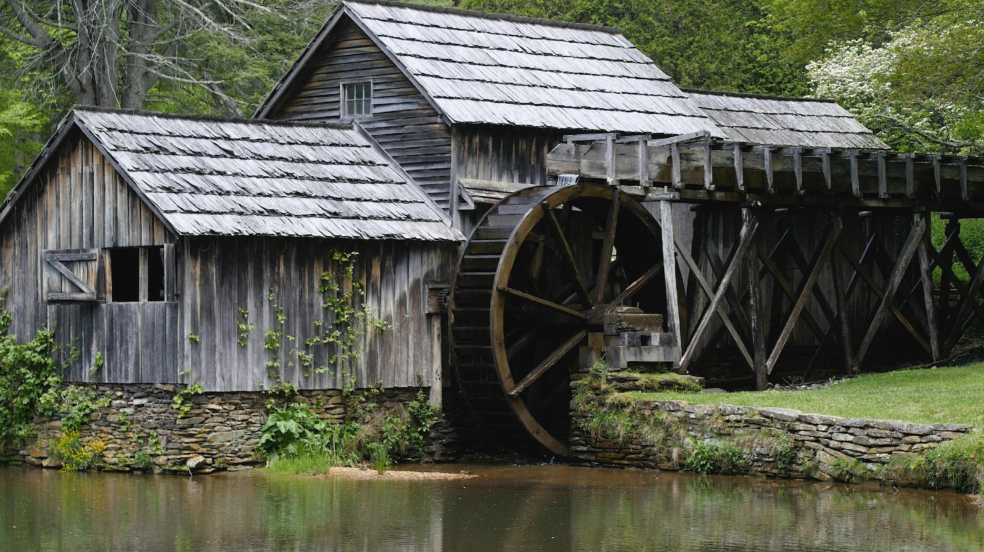

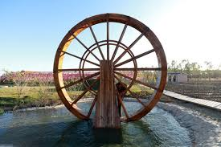
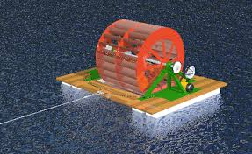

Slide 7
PRODUCT FEATURES
HARDWARE:
WATER WHEEL: A STURDY WHEEL WITH BLADES DESIGNED TO EFFICIENTLY CAPTURE THE ENERGY OF FLOWING WATER.
MECHANICAL TRANSMISSION UNIT: CONNECT THE WATER WHEEL TO AN ELECTRICAL GENERATOR USING TRANSMISSION UNITS SUCH AS A GEAR.
ELECTRICAL GENERATOR: UTILIZING A GENERATOR CAPABLE OF CONVERTING MECHANICAL ENERGY INTO ELECTRICAL ENERGY.
TRANSFORMER: TO SIMPLIFY ELECTRICAL SIGNALS ESPECIALLY IN DC CURRENT
SOFTWARE:
AN OPTION TO TURN ON THE POWER SUPPLY TO YOUR CLASS BASED ON THE PERMISSION GIVEN THROUGH THE USE OF AN ACCESS KEY.

Slide 8
TECHNOLOGY STACK
HARDWARE:
EFFECTIVE WATER FLOW: THE LAGOON WHICH IS THE SOURCE OF OUR PROJECT IS NOT EFFECTIVE ALONE AS IT IS STILL IN THE LOWER COURSE WITH VERY LOW WATER FLOW RATE TO DRIVE THE WATER WHEEL EFFECTIVELY. AS A RESULT, A NARROW TUNNEL WOULD BE CREATED TO INCREASE THE WATER FLOW RATE THAT WILL DRIVE THE WHEEL. THE LAGOON IS ESTIMATED TO HAVE A FLOW RATE OF 0.5 M³/S . BUT WITH THE USE OF A TUNNEL, THE FLOW RATE IS INCREASED TO 3.12 M³/S.
THE WHOLE CAMPUS CONSUMES A TOTAL POWER OF 400KVA. TO CALCULATE HOW MUCH POWER CAN BE GENERATED,
CONSIDERATION OF MATERIAL: STAINLESS STEEL AND LIGHT NON-CORROSIVE COMPOSITE MATERIALS WOULD BE IMPLEMENTED TO AVOID CORROSION, WOOD WETNESS AND GIVE THE REQUIRED DURABILITY AND OPTIMUM PERFORMANCE.
AN AMPLIFIER: TO AMPLIFY ELECTRIC SIGNALS AND PRODUCE DC CURRENT DIRECTLY. A TRANSFORMER CAN CARRY OUT THIS TASK.
POWER(W)=Η×Ρ×G×Q×H
WHERE:
Η IS THE EFFICIENCY OF THE SYSTEM.
Ρ IS THE DENSITY OF WATER (1000 KG/M³).
G IS THE ACCELERATION DUE TO GRAVITY (9.81 M/S²).
Q IS THE FLOW RATE IN CUBIC METERS PER SECOND (M³/S).
H IS THE HEAD IN METERS (M).
FLOW RATE (Q): 3.12 M³/S
HEAD (H): 10 M
EFFICIENCY (Η): 0.7 (70%)
THE POWER CAN BE CALCULATED AS:
POWER=0.7×1000×9.81×3.12×10
POWER≈214.25KW

Slide 9
TECHNOLOGY STACK
SOFTWARE:
1. Node.js
Role: A JavaScript runtime built on Chrome's V8 engine.
Purpose: Enables server-side scripting, allowing me to build scalable network applications and handle multiple connections simultaneously.
2. Express.js
Role: A web application framework for Node.js.
Purpose: Simplifies the process of building web applications and APIs by providing robust features like routing, middleware support, and request/response handling.
3. HTML/CSS
Role: Core technologies for building web pages.
Purpose: HTML structures the content of my web application, while CSS is used for styling and layout. This combination ensures that my application is visually appealing and user-friendly.
4. JavaScript
Role: The primary programming language for web development.
Purpose: Used on the client-side for dynamic content and interaction, as well as on the server-side (via Node.js) for backend logic. It allows me to handle events, make API calls, and manipulate the DOM.

Slide 10
TECHNOLOGY STACK
5. Body-Parser
Role: A middleware for Express.
Purpose: Parses incoming request bodies in a middleware, making it easier to handle JSON data from client requests.
6. Mock Database
Role: Simulated data storage.
Purpose: Used for testing and development, allowing me to define teacher data and their courses directly within my application without needing a separate database setup.
7. Deployment Platforms (e.g., Heroku)
Role: Cloud service for hosting applications.
Purpose: Provide an easy way to deploy your web application, making it accessible via a public URL. It manages scaling, uptime, and server maintenance, allowing me to focus on development.
.

Slide 11
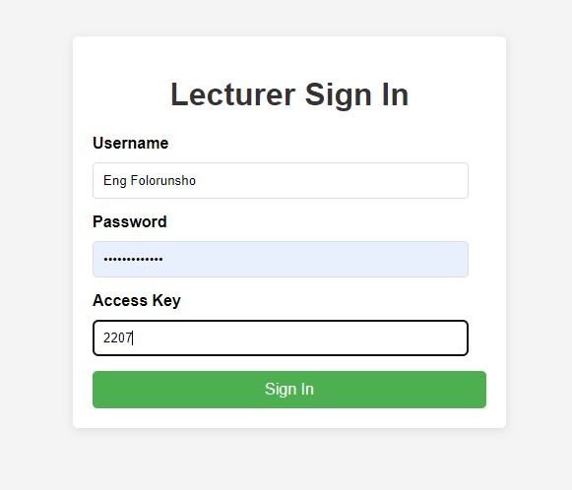
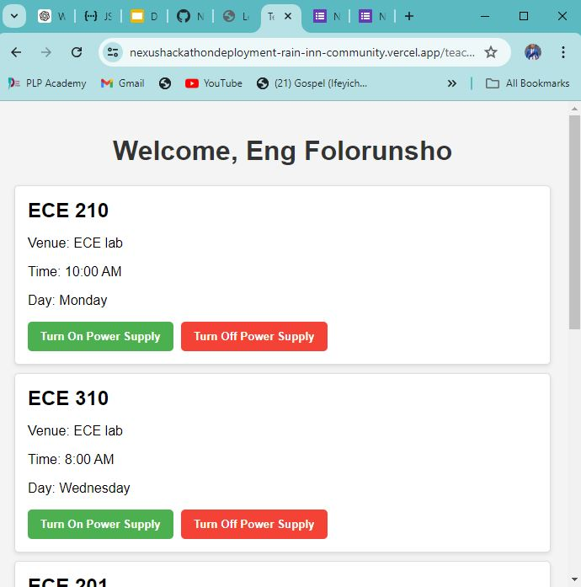
SCREENSHOTS OF THE APP
This is the Sign in page for the lecturer/lab instructor to fill his details
This next page carries all his/her class schedule information.

Slide 12
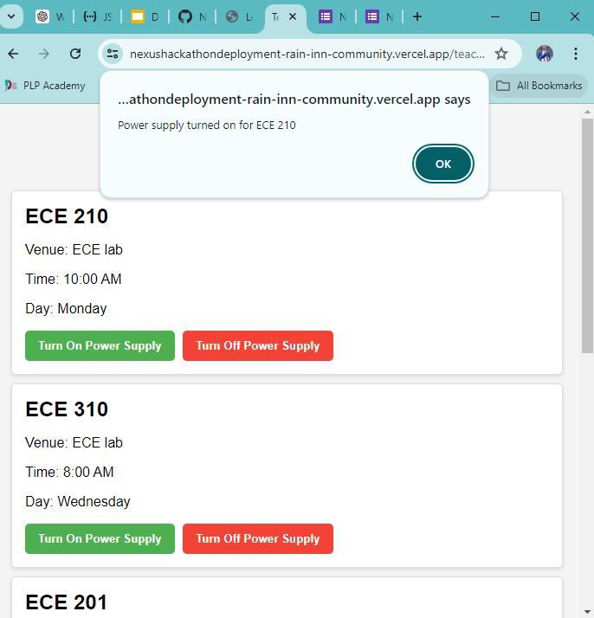
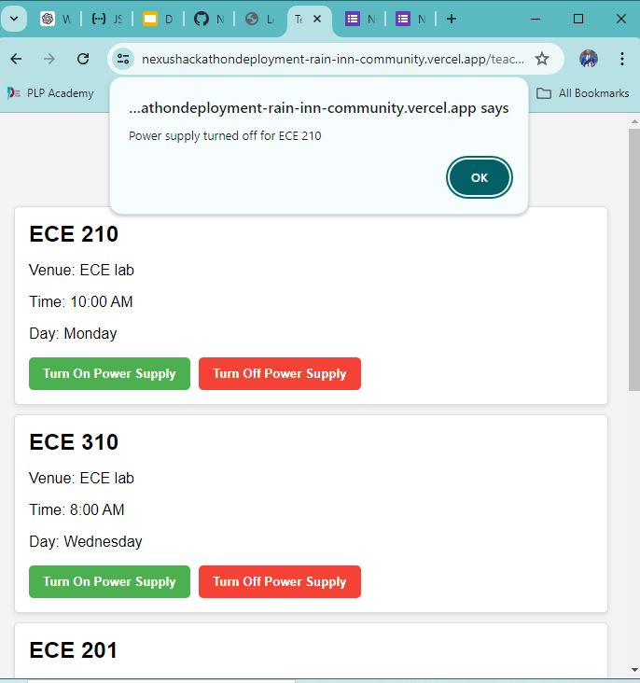
SCREENSHOTS OF THE APP
This message is shown when the Turn On Power Supply is clicked
This message is shown when the Turn Off Power Supply is clicked

Slide 13
DEMONSTRATION COMPONENTS USED
SMALL SCALE DIY
1. WATER WHEEL
MATERIAL: PLASTIC OR LIGHTWEIGHT WOOD
2. SHAFT AND BEARINGS
- MATERIAL:
FOR SHAFT: STEEL
FOR BEARINGS: STEEL
3. GENERATOR
- TYPE: SMALL DC MOTOR (PERMANENT MAGNET DC MOTOR)
4. MOUNTING STRUCTURE
- MATERIAL: WOOD
5. WATER INTAKE AND DISCHARGE SYSTEM
- MATERIAL: RECYCLED PLASTIC BOTTLES.
6. ELECTRICAL COMPONENTS
- ITEMS: BASIC WIRING, CONNECTORS, SMALL LED (TO DEMONSTRATE POWER GENERATION), AND LOAD.
7. MISCELLANEOUS
- ITEMS: GLUE, TAPE, FASTENERS.
MAIN PROJECT
1. WATER WHEEL
MATERIAL: COMPOSITE. THE SPECIFIC MATERIAL IS CARBON FIBER
2. SHAFT AND BEARINGS
- MATERIAL:
FOR SHAFT: 304 STAINLESS STEEL
FOR BEARINGS: POLYTETRAFLUOROETHYLENE ALSO KNOWN AS PTFE POLYMER
3. GENERATOR
- TYPE: PERMANENT MAGNET DC MOTOR
4. BATTERY
TYPE: LITHIUM IRON PHOSPHATE BATTERY
5. MOUNTING STRUCTURE
- MATERIAL: MARINE GRADE ALMINUM
6. WATER INTAKE AND DISCHARGE SYSTEM
- MATERIAL: HIGH DENSITY POLYTHENE
7. ELECTRICAL COMPONENTS
DC-AC INVERTER
WIRES
CHARGE CONTROLLER

Slide 14
BENEFITS
ENVIRONMENTAL BENEFITS:
RENEWABLE ENERGY SOURCE: WATER FLOW IS RENEWABLE ENERGY SOURCE, MAKING HYDROPOWER AN ENVIRONMENTAL FRIENDLY ALTERNATIVE TO FOSSIL FUELS.
LOW GREENHOUSE GAS EMISSIONS: HYDROPOWER GENERATION PRODUCES MINIMAL GREENHOUSE GAS EMISSIONS COMPARED TO CONVENTIONAL FOSSIL FUEL- BASED ELECTRICITY GENERATION METHODS.
MINIMAL HAZARDOUS ENVIRONMENTAL IMPACT: PROPERLY DESIGNED HYDROPOWER SYSTEMS HAVE FEWER NEGATIVE IMPACT ON THE ENVIRONMENT, PARTICULARLY WHEN COMPARED WITH OTHER METHODS OF GENERATING ELECTRICITY.
CONTRIBUTION TO SDGS
GOAL 7: AFFORDABLE AND CLEAN ENERGY.
HYDRO POWER CONTRIBUTES TO PROVIDING ACCESS TO AFFORDABLE, RELIABLE, SUSTAINABLE AND MODERN ENERGY FOR ALL.
GOAL 13: CLIMATE ACTION:
HYDRO POWER HELPS TO MITIGATE CLIMATE CHANGE BY REDUCING GREENHOUSE GAS EMISSIONS ASSOCIATED WITH ELECTRICITY GENERATION.
GOAL 15: LIFE ON LAND:
HYDRO POWER PROJECT ARE DESIGNED TO MINIMIZE HABITAT DISRUPTION AND PROMOTE BIODIVERSITY CONSERVATION.

Slide 15
CONCLUSION
GENERATION ELECTRICITY USING WATER FLOW AND WATER WHEEL IS A SUSTAINABLE AND ENVIRONMENTAL FRIENDLY METHOD WITH SIGNIFICANT POTENTIAL FOR CONTRIBUTING TO CLEAN ENERGY PRODUCTION AND ACHIEVING SUSTAINABLE DEVELOPMENT GOALS.
BY HARNESSING THE KINETIC ENERGY OF FLOWING WATER AND INCORPORATING SMART TECHNOLOGY, THIS METHOD OFFERS A RELIABLE AND RENEWABLE ENERGY SOURCE AND WOULD BE SUSTAINABLE BENEFIT FOR THE EPE CAMPUS AND ANY CAMPUS THAT SEEKS TO MAXIMIZE THE ELECTRICAL SUPPLY.

Slide 16
THANK YOU

